Slide 1
Thinking in Parallel
Uzi Vishkin

Slide 2
Overview
Introduction
Objective
Model of Parallel Computation
Work Depth Model ( ~ PRAM)
Informal Work Depth Model
PRAM Model
Technique: Balanced Binary Trees; Problem: Prefix-Sums
Application – The compaction problem
Putting Things Together
Technique: Informal Work-Depth (IWD)
Technique: Accelerating Cascades
Problem: Selection

Slide 3
Objective
Single task completion time* & task through put
Using compiler methods to achieve parallelism is insufficient
A solution: conceptualize the parallelism in the algorithm first
Goal: seek & develop proper levels of abstractions for designing parallel algorithms

Slide 4
Models of parallel computation
Work-Depth(WD) : present algorithmic methods and paradigms including their complexity analysis and in their rigorous manner
PRAM ~ WD
Informal Work Depth (IWD): outline ideas and high level descriptions of algorithms

Slide 5
Why WD model ?
Unique knowledge-base
Simplicity
Reusability
To get started
Performance prediction
Formal emulation

Slide 6
IWD vs. WD
IWD better than WD in training the mind to “think in parallel”.
Direct hardware implementation of some routines
The ongoing evolution of programming languages.

Slide 7
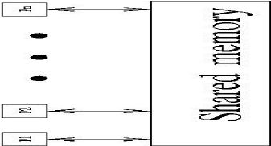
PRAM model
n synchronous processors all having unit time access to a shared memory.
Each processor has also a local memory.
At each time unit, a processor can:
write into the shared memory (i.e., copy one of its local memory registers into a shared memory cell),
read into shared memory (i.e., copy a shared memory cell into one of its local memory registers ), or
do some computation with respect to its local memory.

Slide 8
pardo Programming construct
for Pi , 1 ≤i ≤n pardo
A(i) := B(i)
This means
The following n operations are performed concurrently: processorP1 assigns B(1) into A(1), processor P2 assigns B(2) into A(2), ….

Slide 9
Modeling read & write conflicts to the same shared memory location
exclusive-read exclusive-write (EREW) PRAM: no simultaneous access by more than one processor to the same memory location for read or write purposes
concurrent-read exclusive-write (CREW) PRAM: concurrent access for reads but not for writes
concurrent-read concurrent-write (CRCW allows concurrent access for both reads and writes. We shall assume that in a concurrent-write model, an arbitrary processor among the processors attempting to write into a common memory location, succeeds. This is called the Arbitrary CRCW rule. There are two alternative CRCW rules:
Priority CRCW: the smallest numbered, among the processors attempting to write into a common memory location, actually succeeds.
Common CRCW: allows concurrent writes only when all the processors attempting to write into a common memory location are trying to write the same value.

Slide 10
Summation Problem
Input: An array A = A(1) . . .A(n) of n numbers
The problem is to compute A(1) + . . . + A(n)
Algorithm:
works in rounds
In each round, add, in parallel, pairs of elements as follows:
add each odd-numbered element and its successive even-numbered element.

Slide 11
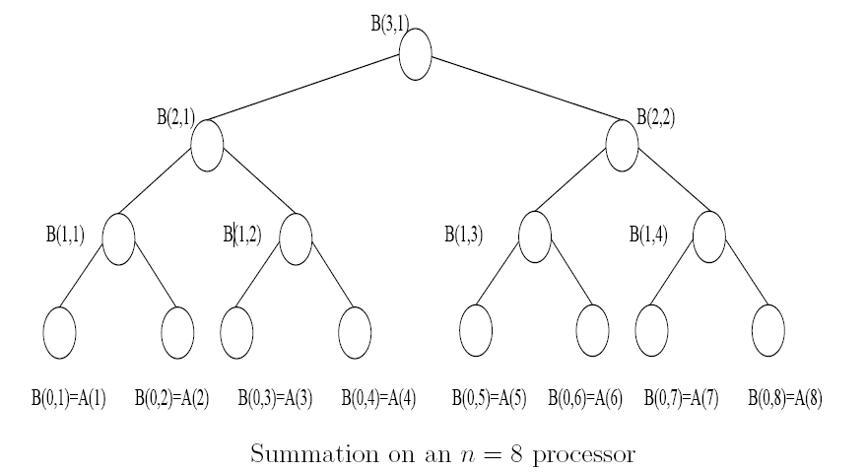
Summation Problem

Slide 12
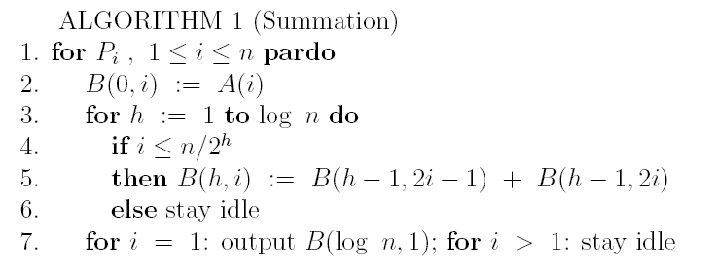
Summation Algorithm in PRAM
# of processors p = n
a time unit consists of a sequence of exactly p instructions to be performed concurrently.

Slide 13
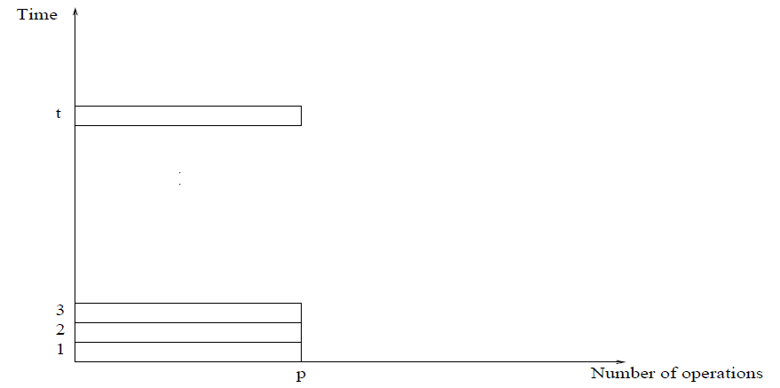
PRAM presentation

Slide 14
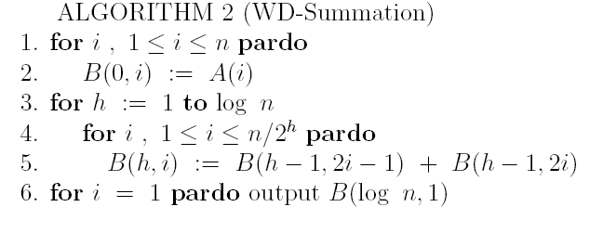
Summation algorithm in WD
# of processors p = n
each time unit consists of a sequence of instructions to be performed concurrently
the sequence of instructions may include any number

Slide 15
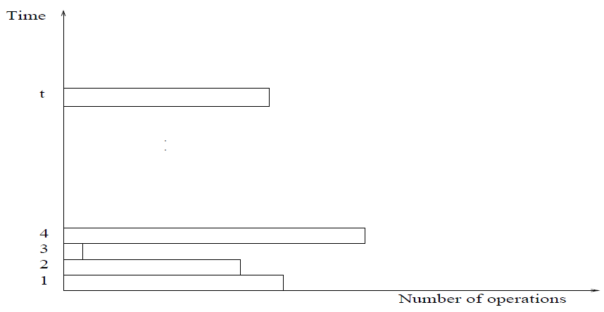
WD presentation

Slide 16
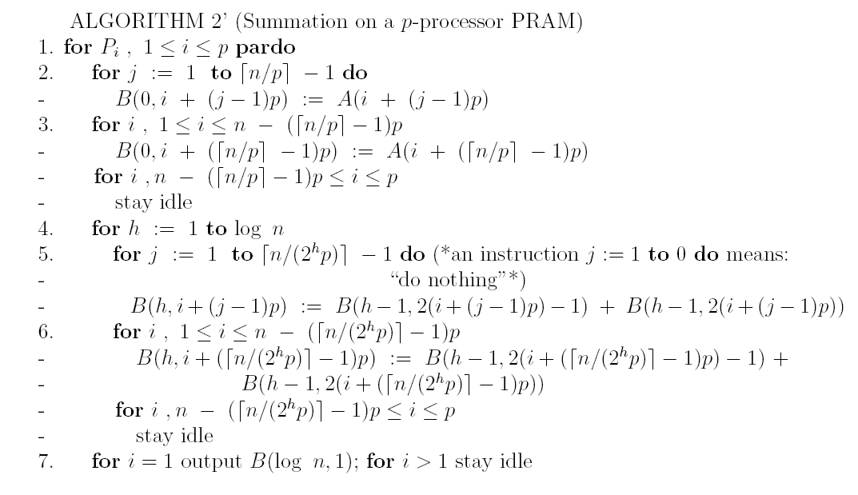
Summation on p-processor PRAM
# of processors p <> n

Slide 17
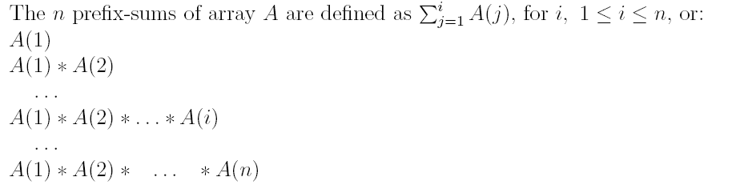
Prefix-Sums Problem
Input: An array A of n elements drawn from some domain
Assume that a binary operation, denoted ∗, is defined on the set.
∗ is associative; namely, for any elements a, b, c in the set, a ∗ (b ∗ c) = (a ∗ b) ∗ c.

Slide 18
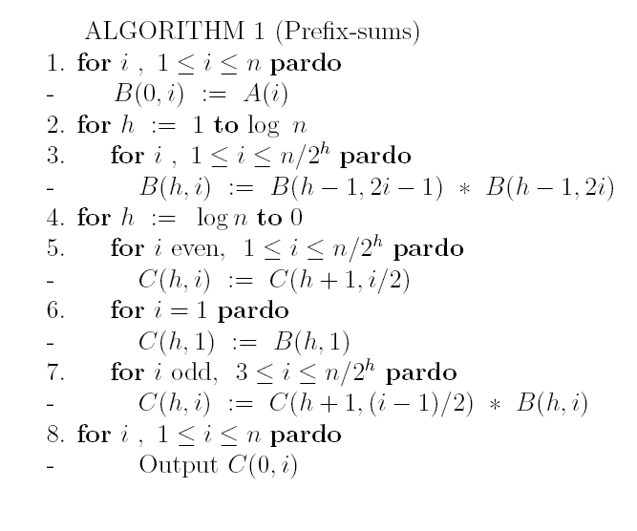
Prefix-sums algorithm

Slide 19
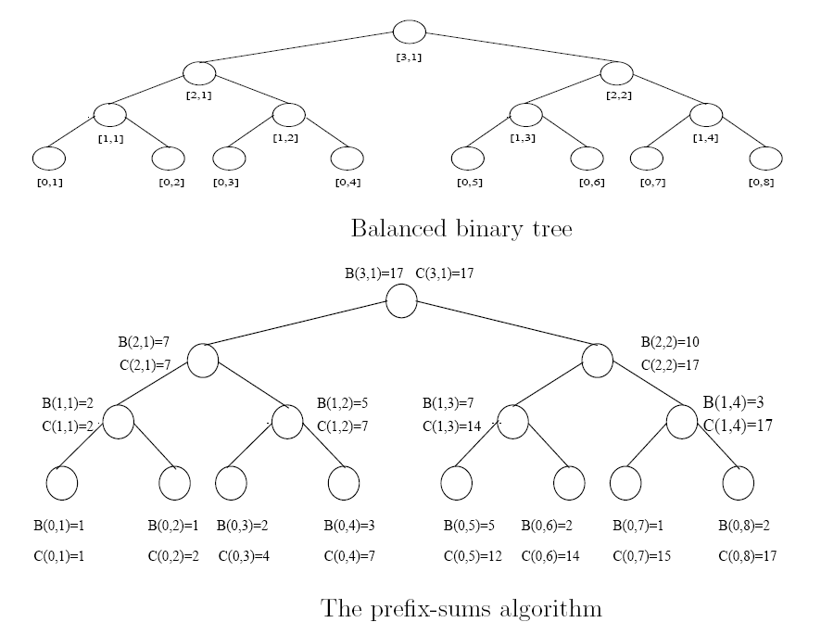
Balanced tree

Slide 20
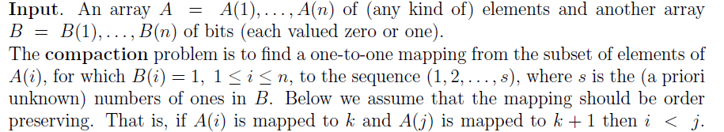
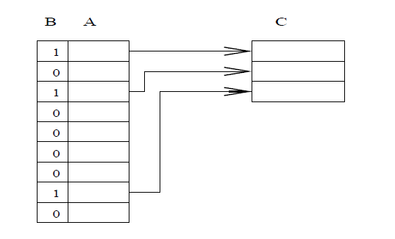
Compaction Problem

Slide 21
The Accelerating Cascades Technique
Situation:
Algorithm A: W1(n) and T1(n).
Algorithm B: W2(n) and T2(n) time.
Suppose:
Algorithm A is more efficient (W1(n) < W2(n)), while algorithm B is faster (T1(n) < T2(n) ).
Algorithm A is a “reducing algorithm”:
Given a problem of size n, Algorithm A operates in phases . Output of each successive phase is a smaller instance of the problem
The accelerating cascades technique composes a new algorithm as follows:
Start by applying Algorithm A. Once the output size of a phase of this algorithm is below some threshold, finish by switching to Algorithm B

Slide 22
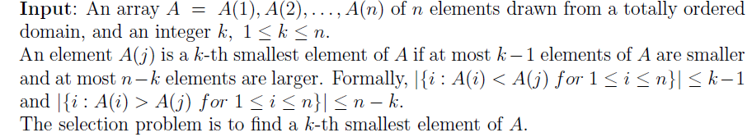
Selection Problem

Slide 23

Selection Algorithm
Algorithm A :
run in
Total work O(n)
Algorithm B: Sorting algorithm
Run in O(logN)
Total work O(nlogN)
Derived algorithm : run in O(lognLogLogn)

Slide 24
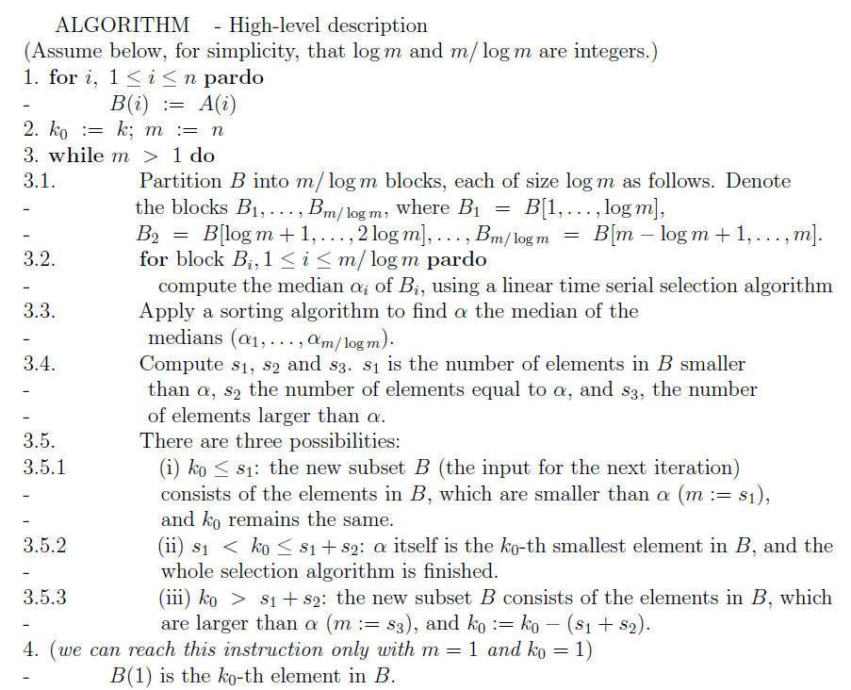
Algorithm A (IWD)

Slide 25
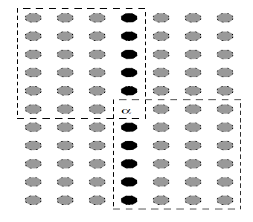
Algorithm A: reducing algorithm
After each iteration of A, the size of the problem is reduced to <= ¾ of the size of the original problem

